Slide 1
Zero To App Mobile Dev Course
Razman
SLIDES:
http://tiny.cc/aa_day1
NOTES: http://tiny.cc/nota_ionic

Slide 2
COURSE OVERVIEW

Slide 3
DAY 1: Introduction to Ionic Framework
DAY 1: Installing Ionic Framework & its tools
DAY 1: HTML, Angular, TypeScript & CSS
DAY 1: Start A Project, Generating Pages & Navigating to it, Run A Project

Slide 4
DAY 2: Executing Functions in TypeScript Programming Navigation in Ionic
DAY 2: Using Angular Commands Using For Loop and *ngFor Using If Else and *ngIF Using (click) Using [(ngModel)]
DAY 2: Using Services, Components & LocalStorage
DAY 2: Using Ionic Native Plugins & Firebase

Slide 5
DAY 3: Resources and Asset preparation for -Progressive Web App -Android Application -iOS Application (for Mac)
DAY 3: Installing & Setting Up Android SDK for PC & Mac Installing & Setting Up iOS for Mac
DAY 3: Publishing you mobile application

Slide 6
INTRODUCE YOURSELF
NAME….
FROM….
Why you enroll?
Experience?

Slide 7

Multi Award Winning Mobile App Developer
About me
-20+ years experience in software development
-Have been involved in a lot of IT based projects
B.Eng Computer Interactive Systems, University of Birmingham, UK
Masters in Management, University Of Wolverhampton, UK
-My speciality is in Javascript based technologies (AngularJS, ExpressJS, NodeJS, Ionic etc)

Slide 8
Multi Award Winning Mobile App Developer
About me
OTHER NOTABLE ROLES
Co Founder & Principal
Ukay Wizards
(2017-)
Former Director,
Kolej Teknologi Timur, Sepang
(2009-2017)
MDEC National Big App Challenge 4.0 Grand Prize Winner
MAB Hackathon Champion 2017
MDEC ICON 2015

Slide 9


Slide 10


Slide 11
OVERVIEW
TO IONIC FRAMEWORK

Slide 12
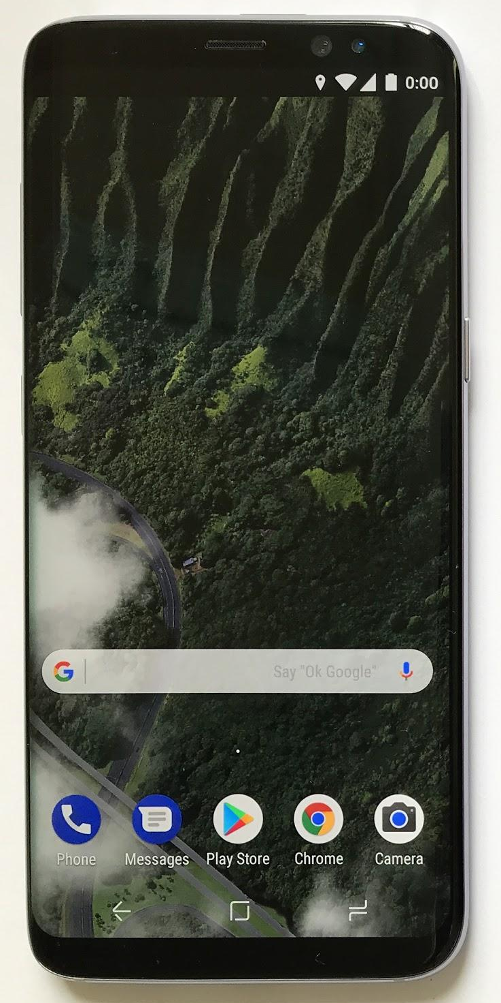
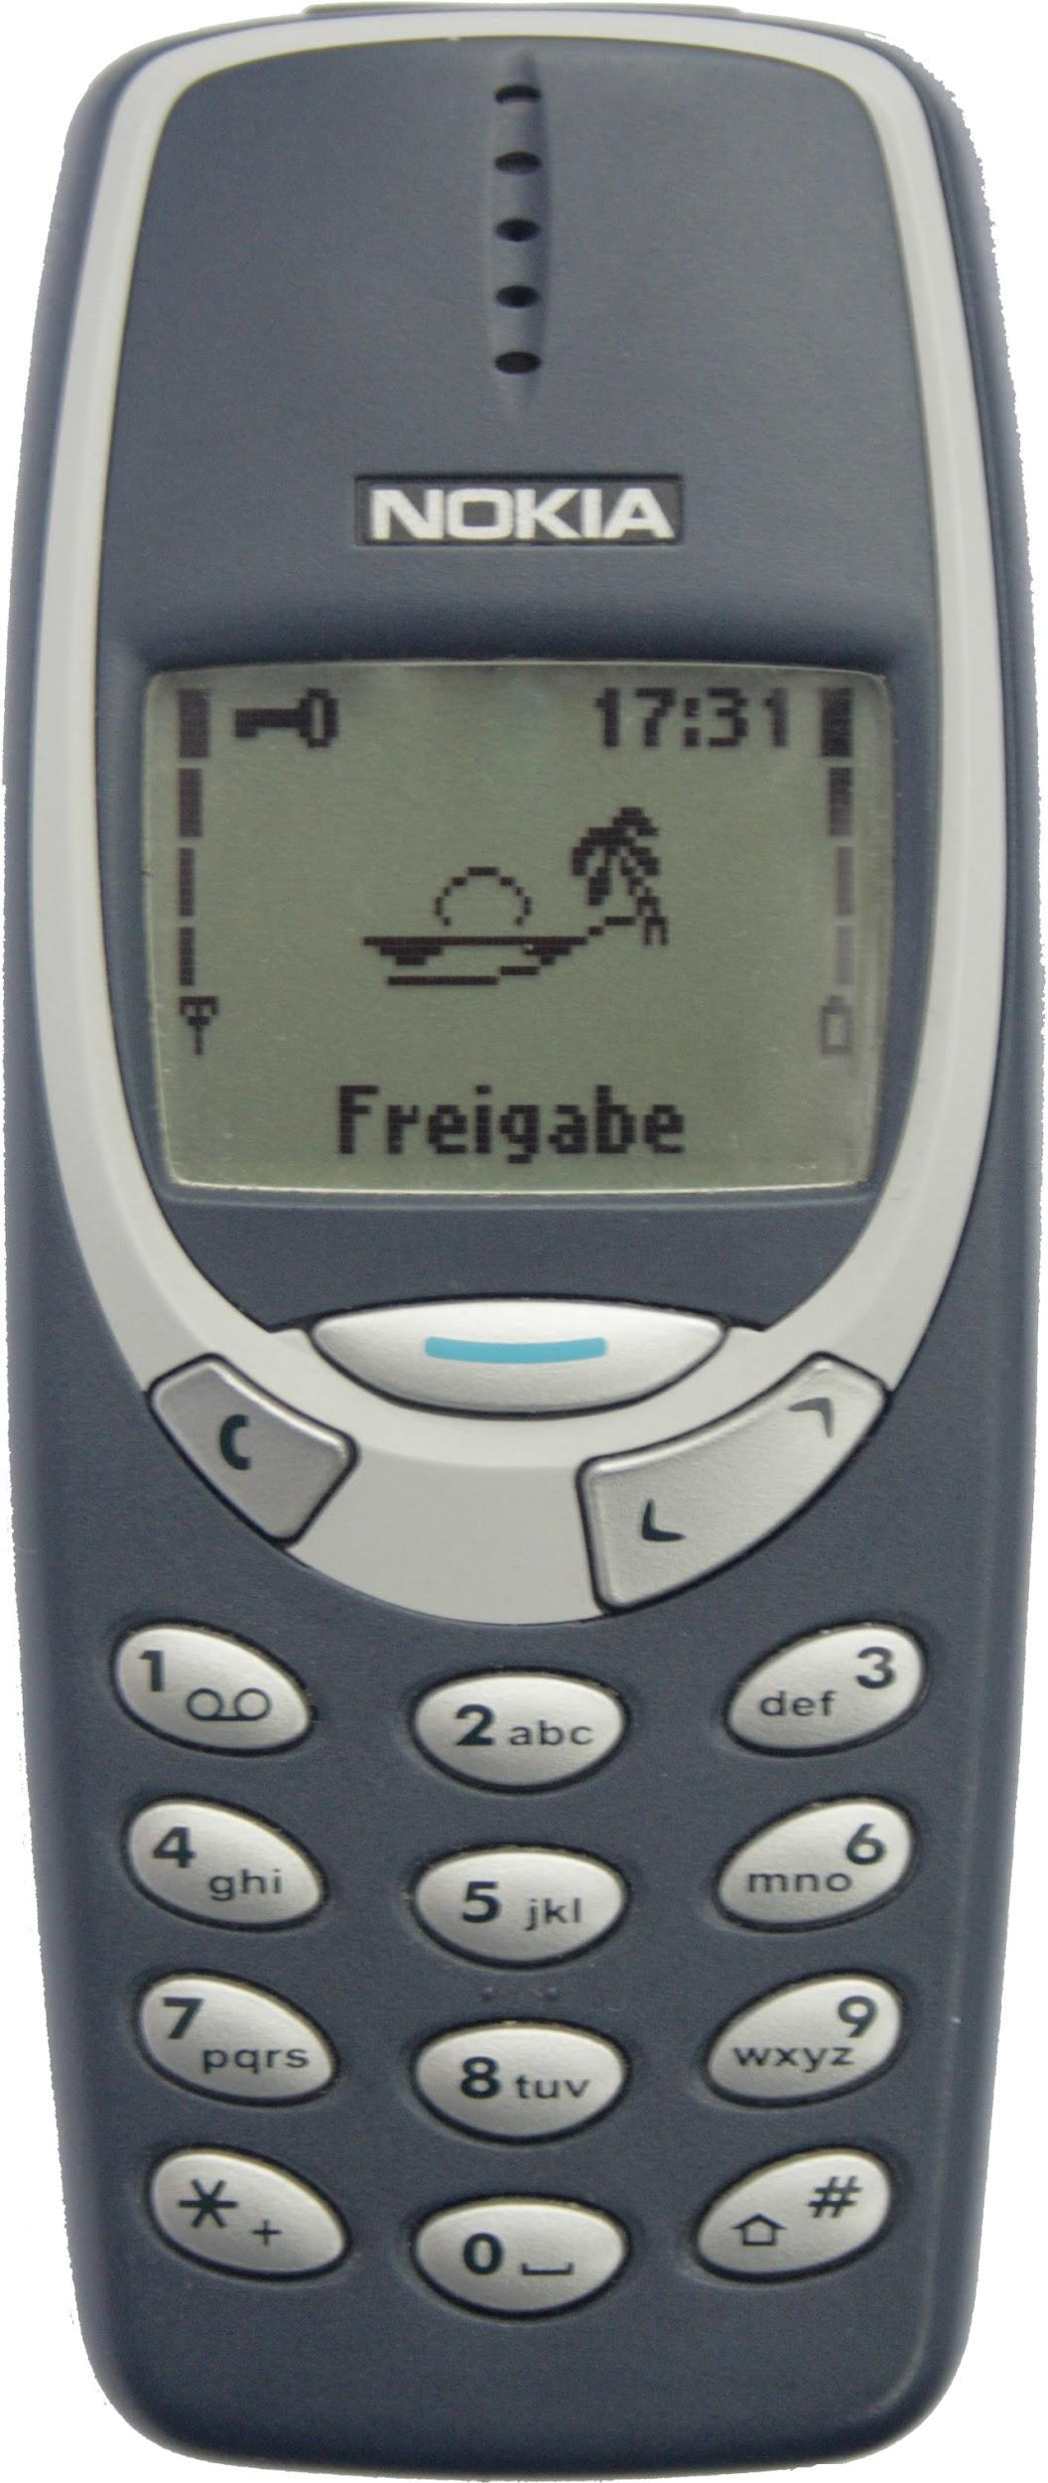
Apps in our life
Mid 1990s - Mid 2010s
Telephone
SMS
Snake
Today

Slide 13
Apps in our life
A mini computer in our pocket
Filled with apps
NOW

Slide 14
Apps in our life
“More information is available about you, ONLINE & IN YOUR PHONE, than there is in your house. Chances are, your phone knows what you’ve been browsing, knows your friends, knows your relationships, has all of your photos, just think about this and the MAGNITUDE of INFORMATION…”
Tim Cook, CEO, APPLE

Slide 15










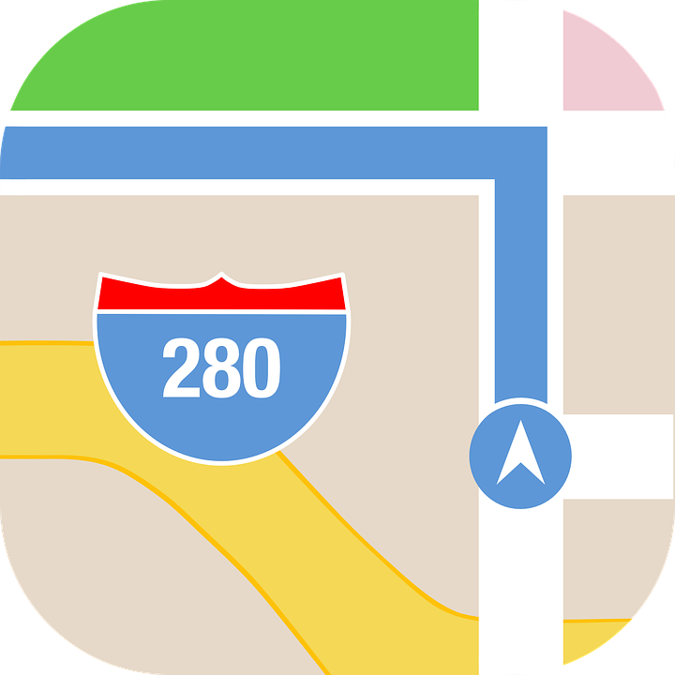


Apps in our life
Alarm Clock
Internet
Whatsapp
Camera
FB & Instagram
Maps
Email

Slide 16
IOS & Android Software Development
In a nutshell

Slide 17
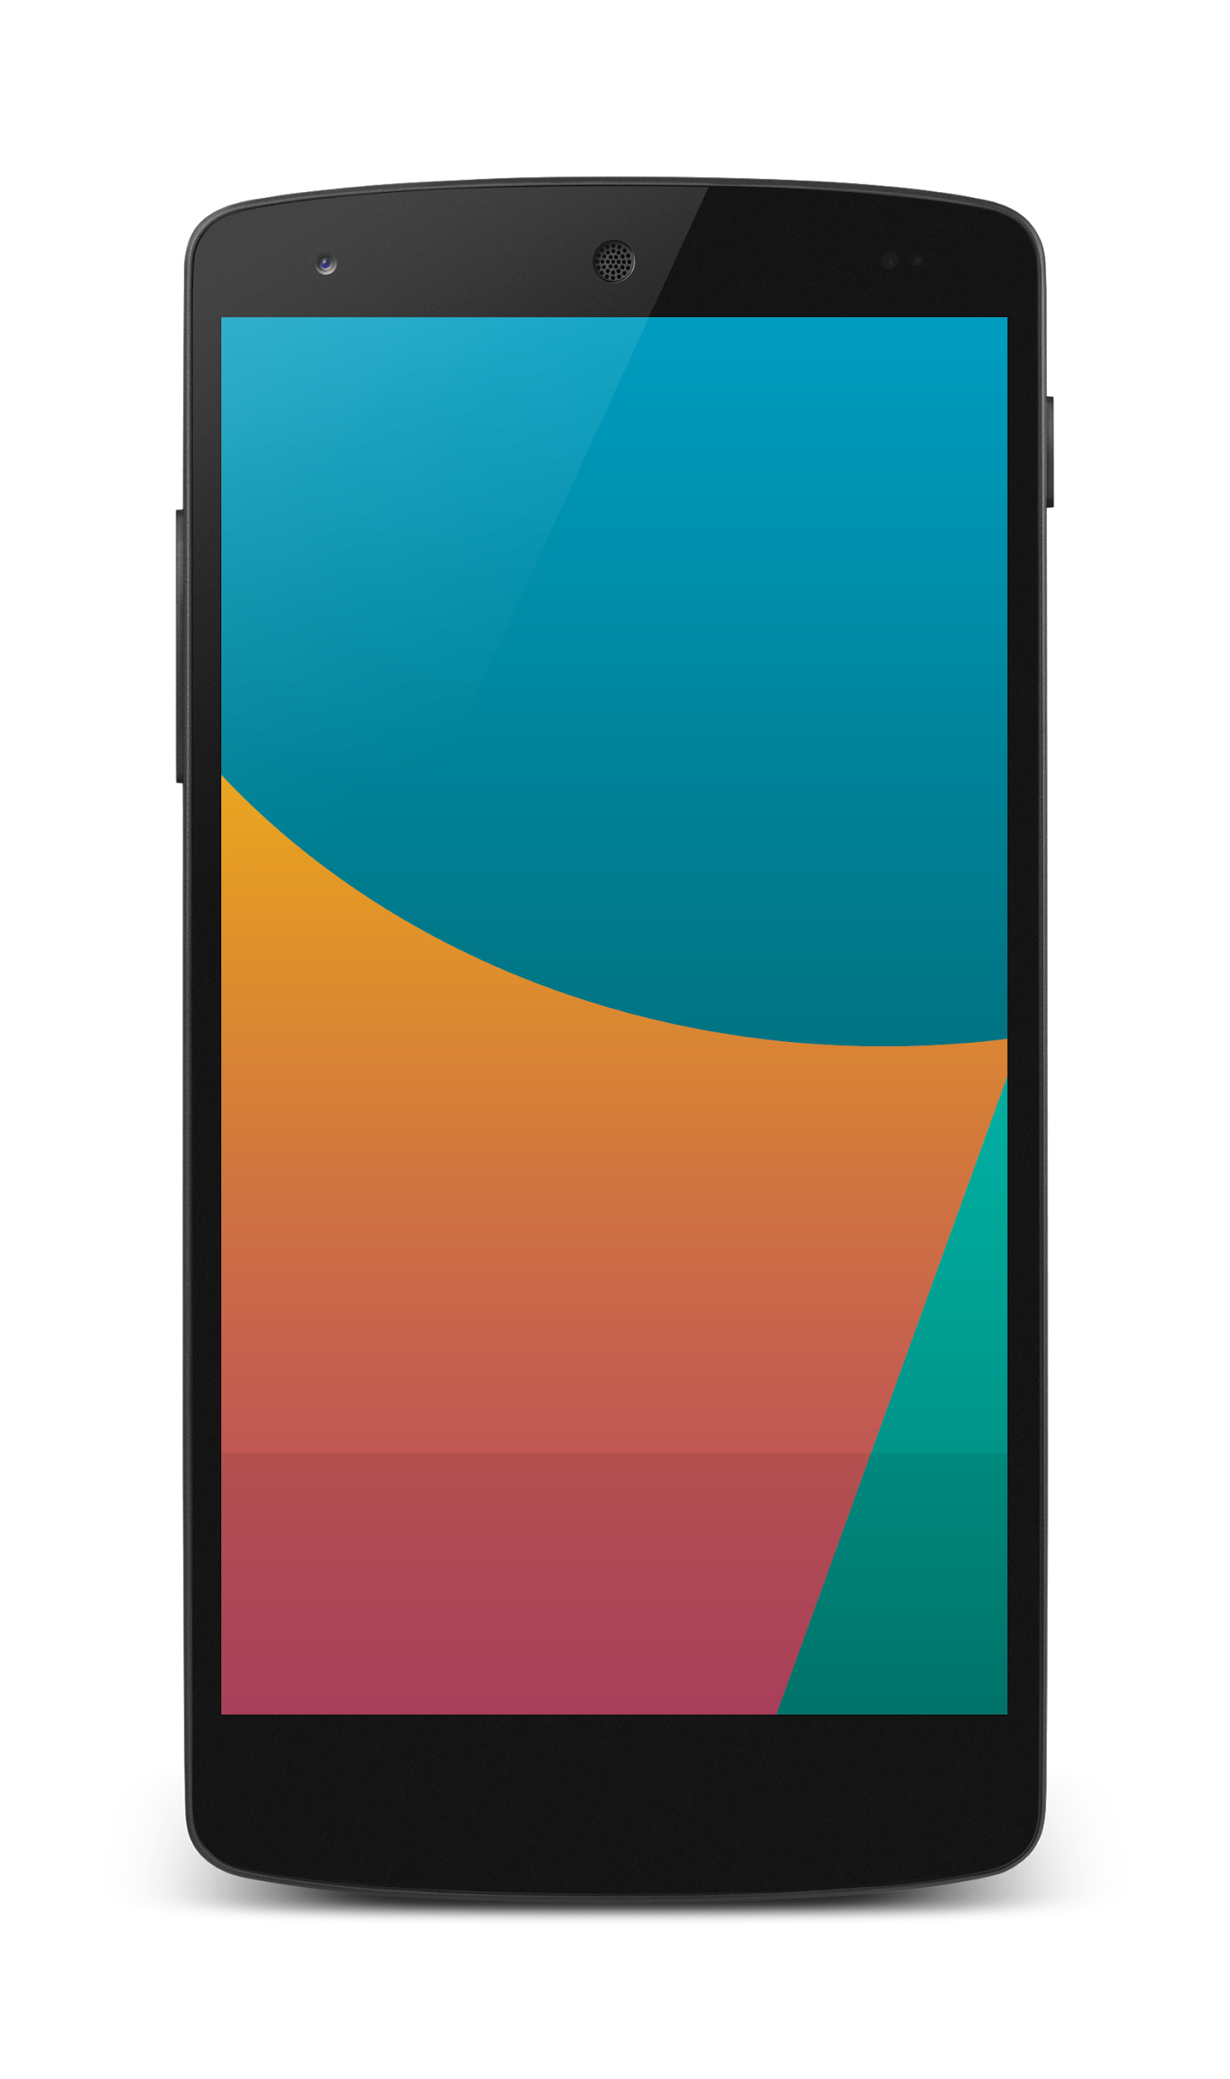


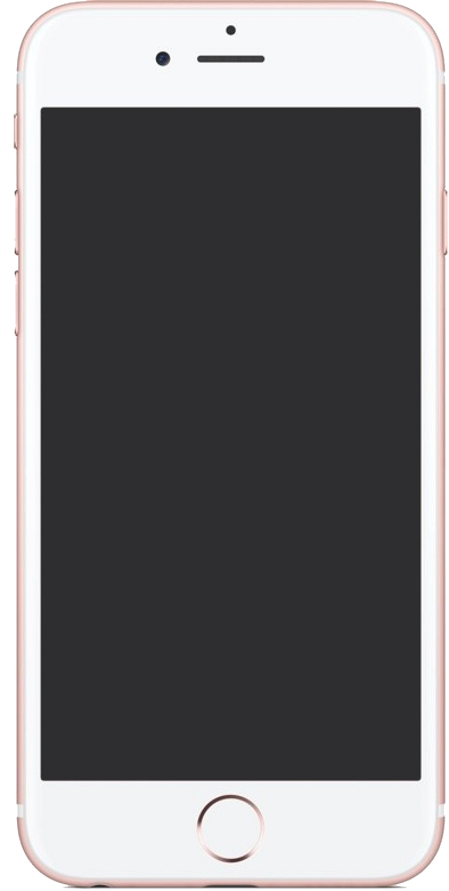

Android Studio
(Java & Kotlin)
Android Device
2 X WORK
XCode (Swift & Objective C)
iPhone/iPad

Slide 18
1 x WORK
Compile with Android SDK
Android Device
Cordova/
Phonegap
Hybrid
Still very messy
No standard framework
Xcode Project
iPhone/iPad

Slide 19

1 x WORK
Compile with Android SDK
Android Device
Cordova
Framework
Hybrid
XCode Project
iPhone/iPad

Slide 20
Cordova
Framework
Hybrid
WEB LAYER
NATIVE APP

Slide 21
1 x WORK
Build Progressive Web Apps
Android Device
Build Progressive Web Apps
Cordova
Framework
Hybrid
iPhone/iPad

Slide 22
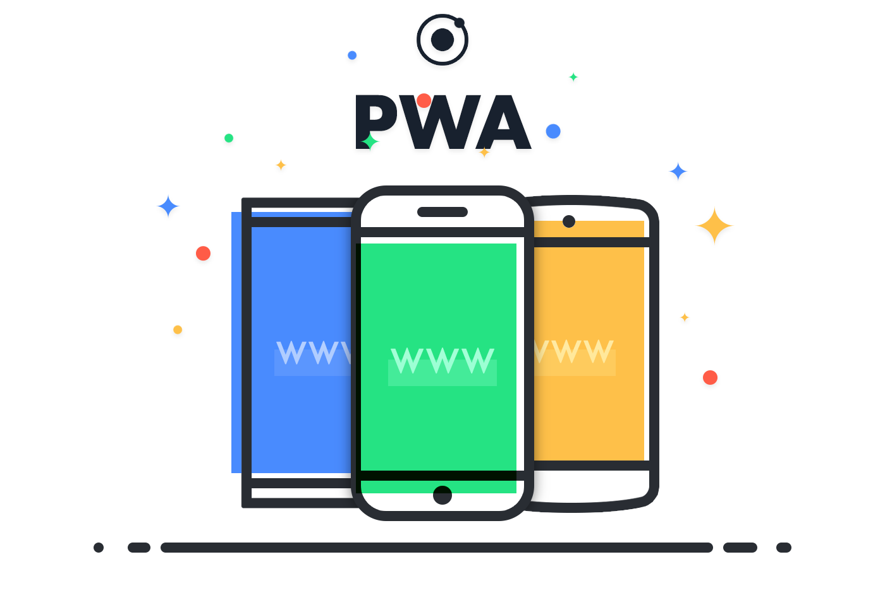
https://ionicframework.com/pwa

Slide 23


1 x WORK
Android Studio
Android Device
+
XCode
iPhone/iPad

Slide 24
https://capacitor.ionicframework.com/

Slide 25



WHY IONIC?
Framework specifically to develop apps
Multiple platforms-Android, IOS, Windows, Amazon etc
Apps development using HTML & Typescript (subset of Javascript)
Plugins (camera, thumbprint, bluetooth, printer etc etc etc)

Slide 26
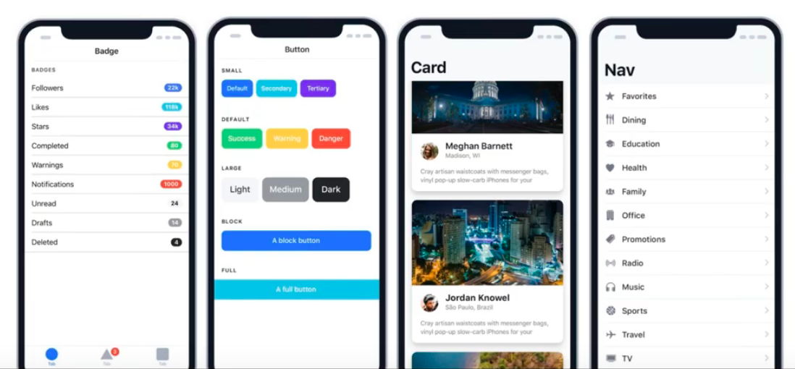
WHY IONIC?
Large COMMUNITY for support
Pre built gestures & animation
100+ UI Components
Everything is OPEN SOURCE
Built with Ionic

Slide 27
What do you need?

Slide 28
What do you need?
To run IONIC:
Node Package Manager (NPM)
Ionic Cordova Framework
Android SDK or Xcode- can be done later
To develop:
VSCode OR any other IDE (with Typescript Plugin)
Google Chrome Web Browser
Register a Gitlab Account
Ionic DevApp

Slide 29
Install NodeJS
node -v
npm -v

Slide 30
2. From command terminal run:
npm install -g ionic cordova

Slide 31
Now, let’s install the tools

Slide 32
Install VSCode
Register Gitlab Account
Install Google Chrome Browser
(If you don’t have, you should)

Slide 33
Before we start coding, some basic stuff...

Slide 34
-HTML?
-CSS or SCSS?
-TypeScript

Slide 35
WHAT YOU JUST DID?
VIEW
-HTML files in the pages folder
-2 already pre built
CONTROLLER
-TS files in the pages folder
-2 already pre built
APP FOLDER
app.module.ts
app.component.ts
Whatever we do, this 2 files VIP
MODEL
-service files
SEES:
button
USES:
helloWorld()
function
USER
This depends on each other, if one is broken, your app will not work

Slide 36
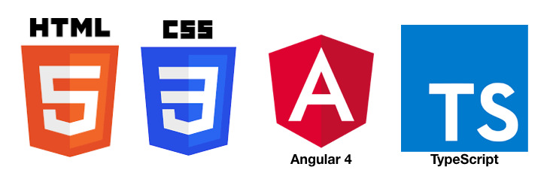
HTML
-Hyper Text Mark Up Language (HTML)
-Used to display the interface
-Write in tags,
-Example- <strong>Hello</strong> → Hello
-Ionic has its own built in tags
<ion-list></ion-list>
<ion-item></ion-item>
<ion-grid></ion-grid>
-HTML in Ionic is “AngularJS Flavoured”
-Have to use Angular Syntax for data and clicks
-Example- (click), *ngFor etc

Slide 37
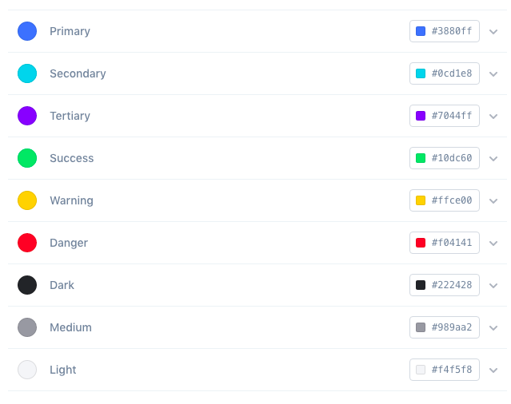
CSS or SCSS
-Cascading Style Sheets (CSS)
-Used for styling, very straightforward
-Each generated Ionic page comes with built in own CSS
-Can assist in ‘theming’ the app
-Ionic has standard built in colours
-Primary, Secondary, Danger, Light & Dark
Built in colours that can be added/edited

Slide 38
TypeScript
-A subset of Javascript
-Part of ECMA6 standard
-The ‘brains’ behind your app
-Used for processing & handling data
Example- calculation, accessing DB etc
-Ionic has standard built in to its TS:
NavController, ModalController etc
VARIABLES NEXT SLIDE

Slide 39
TypeScript
Data types:
Var
can be numbers or words
String
can only be words
Objects
{name: “Mickey”}
Array
can be a collection of Var, Strings or Objects
What is a variable?
A variable, by definition, is “a named space in the memory” that stores values
In other words, it acts as a container for values in a program

Slide 40
Let’s START BUILDING OUR FIRST APP...

Slide 41
Building a
Hello World app

Slide 42
1. Start a project
ionic start myFirstApp

Slide 43
2. CD into Directory & Run the project
ionic serve

Slide 44
Try building a button and make an alert
helloWorld(){
alert(“Hello World”)
}
<ion-button (click)=”helloWorld()”> ALERT </ion-button>
In home.ts
In home.html

Slide 45
Page Navigation
3 methods

Slide 46
routerLink in HTML
PAGE 1
PAGE 2
See app-routing.module.ts for page name

Slide 47
NavController in TS
PAGE 1
PAGE 2
See app-routing.module.ts for page name

Slide 48
ModalController
PAGE 1
PAGE 2
Layer on Page 1

Slide 49
Let’s generate a page
ionic g page first

Slide 50
Parameters
2 methods

Slide 51
PARAMETERS
PAGE 1
PAGE 2
Name: Razman
Name: Razman
Name: Razman

Slide 52
Using Services,
SEE DAY 2 LESSON
2. Using ActivatedRoute
*CAN SEND OBJECTS
*CANNOT SEND OBJECTS

Slide 53
Using ActivatedRoute
On app-routing.module.ts add param name, example /:id
Add /id when navigating
To get param
import {ActivatedRoute} from ‘@angular/router’
public route:ActivatedRoute
let the_id=this.route.snapshot.params.id

Slide 54

Contact
Razman Sarit
razman@atasawan.net

